Slide 1

Parallel Programming in C with MPI and OpenMP
Michael J. Quinn

Slide 2
Chapter 10
Monte Carlo Methods

Slide 3
Chapter Objectives
Introduce Monte Carlo methods
Introduce techniques for parallel random number generation

Slide 4
Outline
Monte Carlo method
Sequential random number generators
Parallel random number generators
Generating non-uniform random numbers
Monte Carlo case studies

Slide 5
Monte Carlo Method
Solve a problem using statistical sampling
Name comes from Monaco’s gambling resort city
First important use in development of atomic bomb during World War II

Slide 6
Applications of Monte Carlo Method
Evaluating integrals of arbitrary functions of 6+ dimensions
Predicting future values of stocks
Solving partial differential equations
Sharpening satellite images
Modeling cell populations
Finding approximate solutions to NP-hard problems

Slide 7
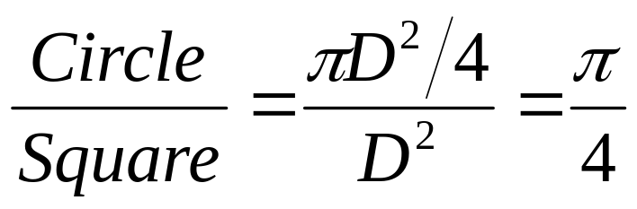
Example of Monte Carlo Method
Area = D²
Area = πD²/4
D
D

Slide 8
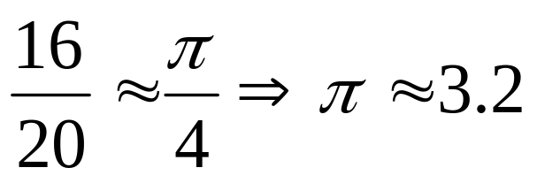
Example of Monte Carlo Method
Area = D²

Slide 9
Absolute Error
Absolute error is a way to measure the quality of an estimate
The smaller the error, the better the estimate
a: actual value
e: estimated value
Absolute error = |e-a|/a

Slide 10
Increasing Sample Size Reduces Error
n | Estimate | Error | 1/(2n^{1/2})
10 | 2.40000 | 0.23606 | 0.15811
100 | 3.36000 | 0.06952 | 0.05000
1,000 | 3.14400 | 0.00077 | 0.01581
10,000 | 3.13920 | 0.00076 | 0.00500
100,000 | 3.14132 | 0.00009 | 0.00158
1,000,000 | 3.14006 | 0.00049 | 0.00050
10,000,000 | 3.14136 | 0.00007 | 0.00016
100,000,000 | 3.14154 | 0.00002 | 0.00005
1,000,000,000 | 3.14155 | 0.00001 | 0.00002

Slide 11
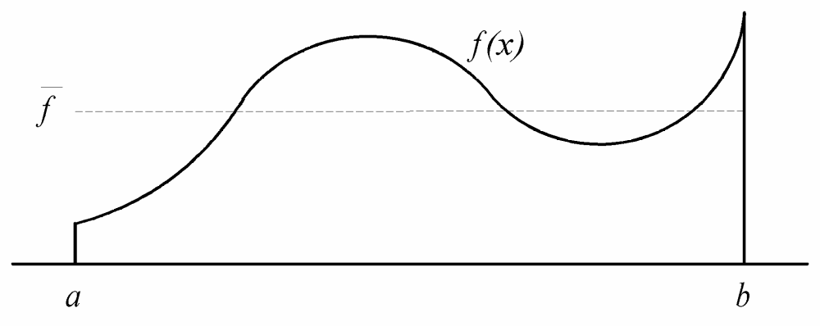
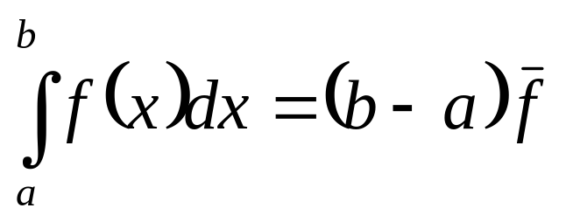
Mean Value Theorem

Slide 12
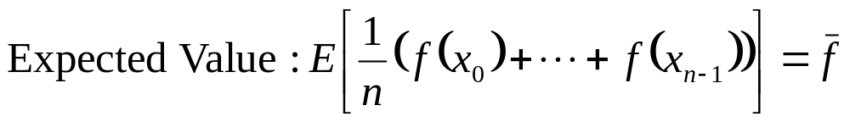
Estimating Mean Value

Slide 13
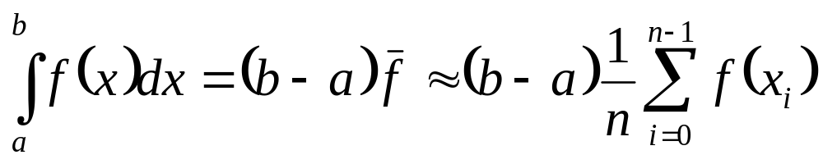
Why Monte Carlo Works

Slide 14
Why Monte Carlo is Effective
Error in Monte Carlo estimate decreases by the factor 1/n^{1/2}
Rate of convergence independent of integrand’s dimension
Deterministic numerical integration methods do not share this property
Hence Monte Carlo superior when integrand has 6 or more dimensions

Slide 15
Parallelism in Monte Carlo Methods
Monte Carlo methods often amenable to parallelism
Find an estimate about p times faster,
OR,
Reduce error of estimate by p^{1/2}

Slide 16
Random versus Pseudo-random
Virtually all computers have “random number” generators
Their operation is deterministic
Sequences are predictable
More accurately called “pseudo-random number” generators
In this chapter “random” is shorthand for “pseudo-random”
“RNG” means “random number generator”

Slide 17
Properties of an Ideal RNG
Uniformly distributed
Uncorrelated
Never cycles
Satisfies any statistical test for randomness
Reproducible
Machine-independent
Changing “seed” value changes sequence
Easily split into independent subsequences
Fast
Limited memory requirements

Slide 18
No RNG Is Ideal
Finite precision arithmetic ⇒ finite number of states ⇒ cycles
  Period = length of cycle
  If period > number of values needed, effectively acyclic
Reproducible ⇒ correlations
Often speed versus quality trade-offs

Slide 19
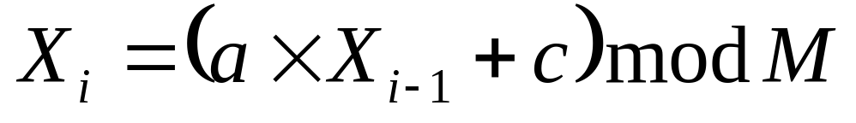
Linear Congruential RNGs
Modulus
Additive constant
Multiplier
Sequence depends on choice of seed, X₀

Slide 20
Period of Linear Congruential RNG
Maximum period is M
For 32-bit integers maximum period is 2³², or about 4 billion
This is too small for modern computers
Use a generator with at least 48 bits of precision

Slide 21
Producing Floating-Point Numbers
X_{i}, a, c, and M are all integers
X_{i} ’s range in value from 0 to M – 1
To produce floating-point numbers in
range [0, 1), divide X_{i} by M

Slide 22
Defects of Linear Congruential RNGs
Least significant bits correlated
  Especially when M is a power of 2
k-tuples of random numbers form a lattice
  Especially pronounced when k is large

Slide 23
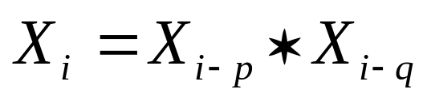
Lagged Fibonacci RNGs
p and q are lags, p > q
* is any binary arithmetic operation
  Addition modulo M
  Subtraction modulo M
  Multiplication modulo M
  Bitwise exclusive-or

Slide 24
Properties of Lagged Fibonacci RNGs
Require p seed values
Careful selection of seed values, p, and q can result in very long periods and good randomness
For example, suppose M has b bits
Maximum period for additive lagged Fibonacci RNG is (2p – 1)2^{b – 1}

Slide 25
Ideal Parallel RNGs
All properties of sequential RNGs
No correlations among numbers in different sequences
Scalability
Locality

Slide 26
Parallel RNG Designs
Manager-worker
Leapfrog
Sequence splitting
Independent sequences

Slide 27
Manager-Worker Parallel RNG
Manager process generates random numbers
Worker processes consume them
If algorithm is synchronous, may achieve goal of consistency
Not scalable
Does not exhibit locality

Slide 28
Leapfrog Method
Process with rank 1 of 4 processes

Slide 29
Properties of Leapfrog Method
Easy modify linear congruential RNG to support jumping by p
Can allow parallel program to generate same tuples as sequential program
Does not support dynamic creation of new random number streams

Slide 30
Sequence Splitting
Process with rank 1 of 4 processes

Slide 31
Properties of Sequence Splitting
Forces each process to move ahead to its starting point
Does not support goal of reproducibility
May run into long-range correlation problems
Can be modified to support dynamic creation of new sequences

Slide 32
Independent Sequences
Run sequential RNG on each process
Start each with different seed(s) or other parameters
Example: linear congruential RNGs with different additive constants
Works well with lagged Fibonacci RNGs
Supports goals of locality and scalability

Slide 33
Other Distributions
Not uniformly distributed
Analytical transformations
Box-Muller Transformation
Rejection method

Slide 34
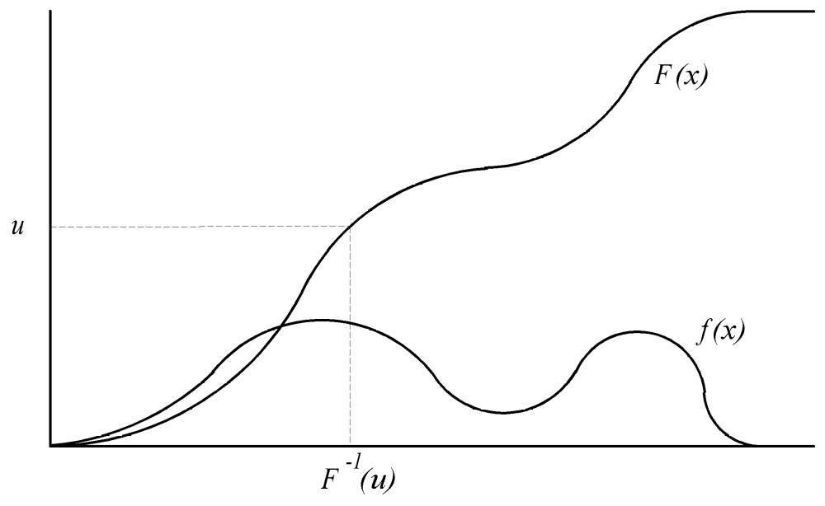
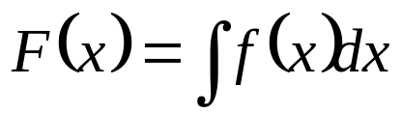
1. Analytical Transformation

Slide 35
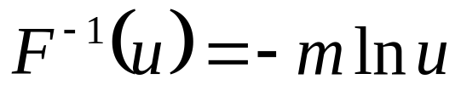
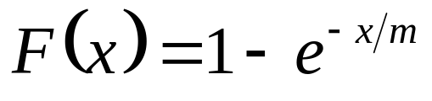
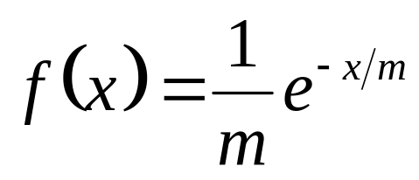
Exponential Distribution
1.0

Slide 36
Example 1:
Produce four samples from an exponential distribution with mean 3
Uniform sample: 0.540, 0.619, 0.452, 0.095
Take natural log of each value and multiply by –3
Exponential sample: 1.850, 1.440, 2.317, 7.072

Slide 37
Example 2:
Simulation advances in time steps of 1 second
Probability of an event happening is from an exponential distribution with mean 5 seconds
What is probability that event will happen in next second?
1/5
Use uniform random number to test for occurrence of event

Slide 38
2. Box-Muller Transformation
Cannot invert cumulative distribution function to produce formula yielding random numbers from normal (gaussian) distribution
Box-Muller transformation produces a pair of standard deviates g₁ and g₂ from a pair of normal deviates u₁ and u₂

Slide 39
Box-Muller Transformation
repeat
v₁ ← 2u₁ – 1
v₂ ← 2u₂ – 1
r ← v₁² + v₂²
until r > 0 and r < 1
f ← sqrt( –2 ln r /r )
g₁ ← f v₁
g₂ ← f v₂

Slide 40
Example
Produce four samples from a normal distribution with mean 0 and standard deviation 1
u₁ | u₂ | v₁ | v₂ | r | f | g₁ | g₂
0.234 | 0.784 | -0.532 | 0.568 | 0.605 | 1.290 | -0.686 | 0.732
0.824 | 0.039 | 0.648 | -0.921 | 1.269
0.430 | 0.176 | -0.140 | -0.648 | 0.439 | 1.935 | -0.271 | -1.254

Slide 41
Different Mean, Std. Dev.
g₁ ← s f v₁ + m
g₂ ← s f v₂ + m
Standard deviation
Mean

Slide 42
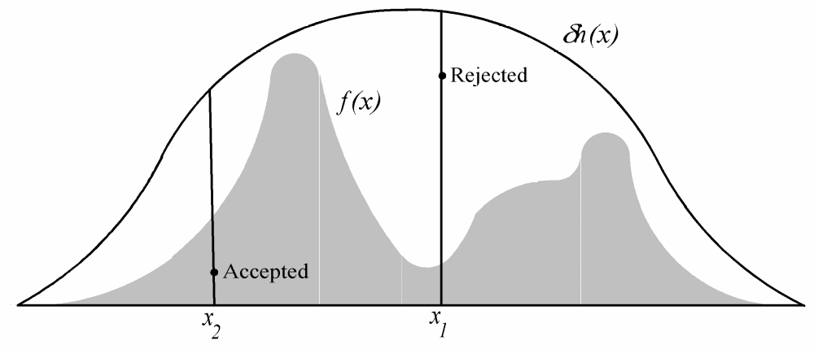
3. Rejection Method

Slide 43
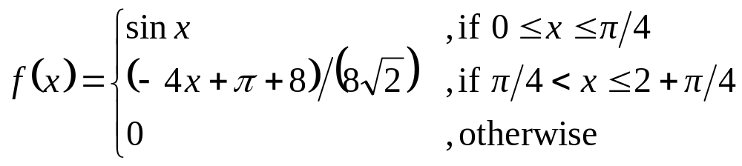
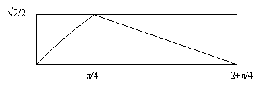
Example
Generate random variables from this probability density function

Slide 44
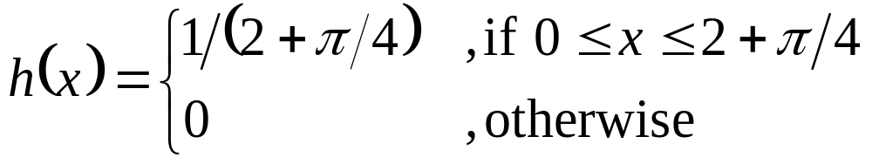
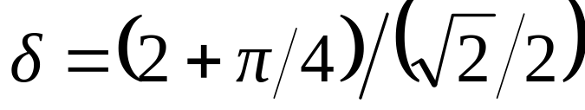
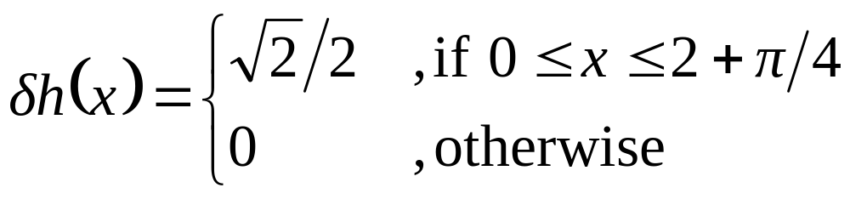
Example (cont.)
So δh(x) ≥ f(x) for all x

Slide 45
Example (cont.)
x_{i} | u_{i} | u_{i}δh(x_{i}) | f(x_{i}) | Outcome
0.860 | 0.975 | 0.689 | 0.681 | Reject
1.518 | 0.357 | 0.252 | 0.448 | Accept
0.357 | 0.920 | 0.650 | 0.349 | Reject
1.306 | 0.272 | 0.192 | 0.523 | Accept
Two samples from f(x) are 1.518 and 1.306

Slide 46
Case Studies (Topics Introduced)
Neutron transport (Monte Carlo time)
Temperature inside a 2-D plate (Random walk)
Two-dimensional Ising model
(Metropolis algorithm)
Room assignment problem (Simulated annealing)
Parking garage (Monte Carlo time)
Traffic circle (Simulating queues)

Slide 47
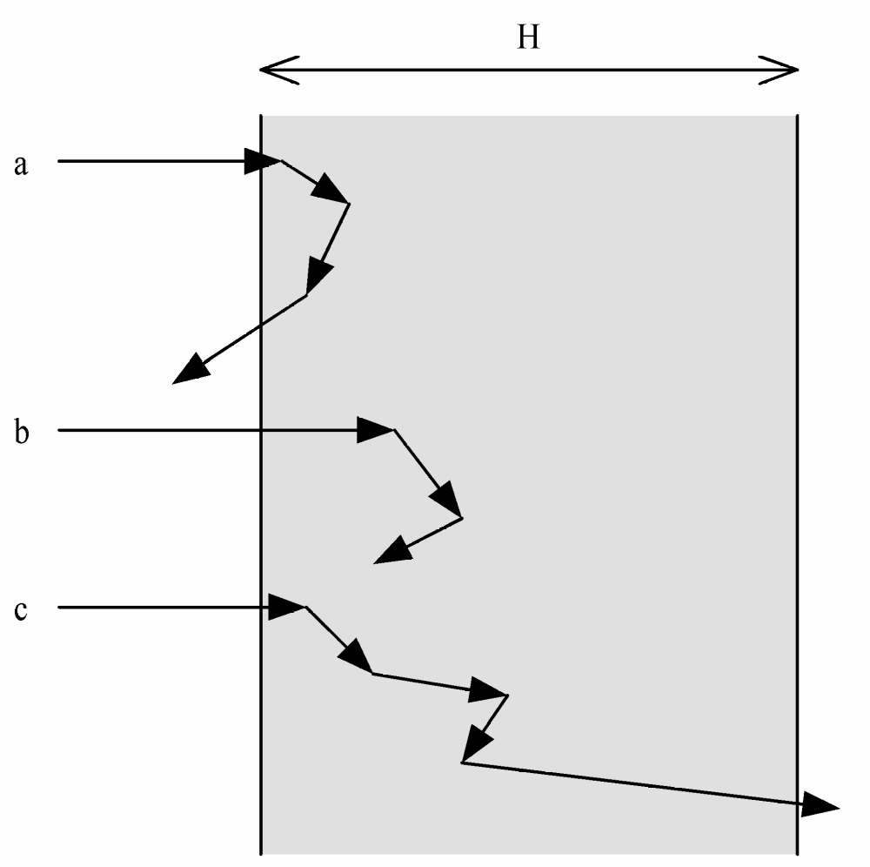
Neutron Transport

Slide 48
Example
3.0
Monte Carlo Time
D (0-π) | Angle | u (0-1) | L (-ln u) | LcosD | Dist. | Absorb? (0-1)
0.00 | 0.0 | 0.20 | 1.59 | 1.59 | 1.59 | 0.41 (no)
1.55 | 89.2 | 0.34 | 1.08 | 0.01 | 1.60 | 0.84 (no)
0.42 | 24.0 | 0.27 | 1.31 | 1.20 | 2.80 | 0.57 (no)
0.33 | 19.4 | 0.60 | 0.52 | 0.49 | 3.29

Slide 49
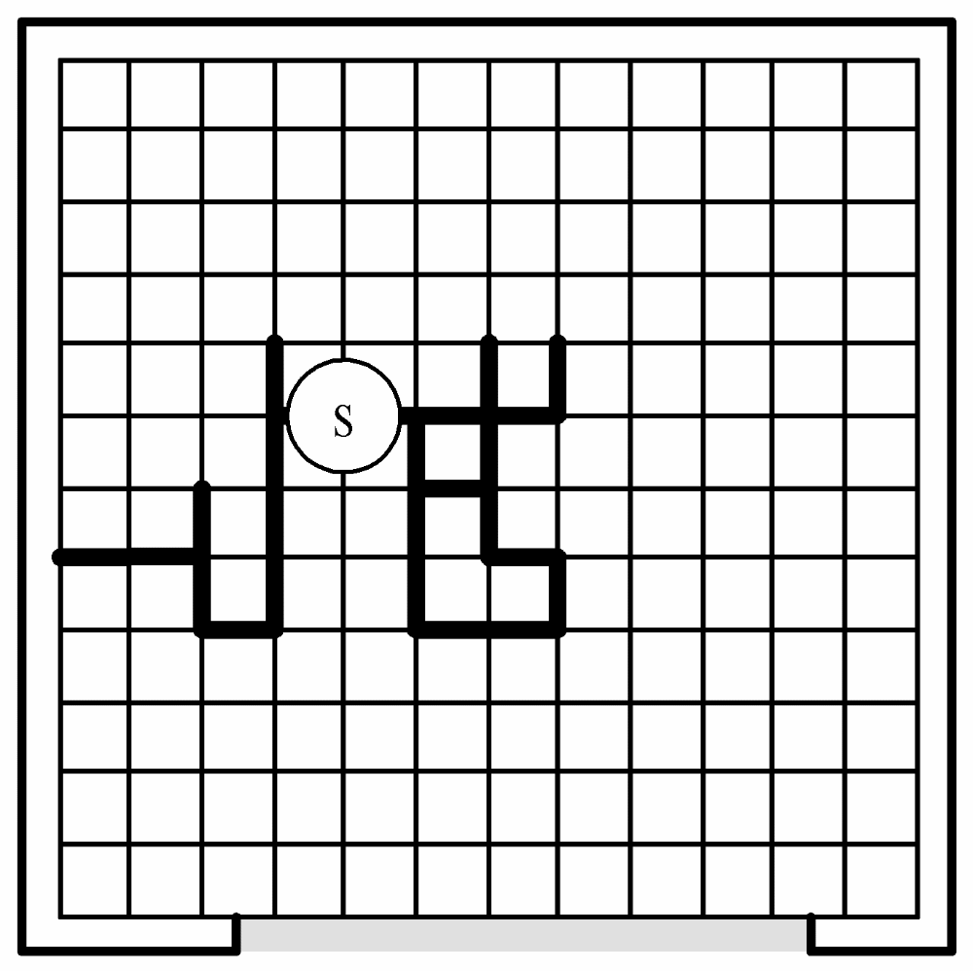
Temperature Inside a 2-D Plate
Random walk

Slide 50
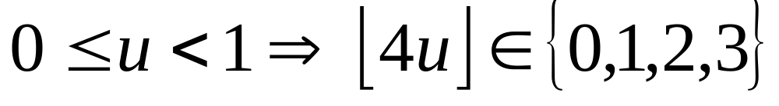
Example of Random Walk
1
3
1
2
1
3
2
2

Slide 51
2-D Ising Model

Slide 52
Metropolis Algorithm
Use current random sample to generate next random sample
Series of samples represents a random walk through the probability density function
Short series of samples highly correlated
Many samples can provide good coverage

Slide 53
Metropolis Algorithm Details
Randomly select site to reverse spin
If energy is lower, move to new state
Otherwise, move with probability ρ = e^{–Δ/kT}
Rejection causes current state to be recorded another time

Slide 54
Room Assignment Problem
 | A | B | C | D | E | F
A | 0 | 3 | 5 | 9 | 1 | 6
B | 3 | 0 | 2 | 6 | 4 | 5
C | 5 | 2 | 0 | 8 | 9 | 2
D | 9 | 6 | 8 | 0 | 3 | 4
E | 1 | 4 | 9 | 3 | 0 | 5
F | 6 | 5 | 2 | 4 | 5 | 0
“Dislikes”
matrix
Pairing A-B, C-D, and E-F leads to total
conflict value of 32.

Slide 55
Physical Annealing
Heat a solid until it melts
Cool slowly to allow material to reach state of minimum energy
Produces strong, defect-free crystal with regular structure

Slide 56
Simulated Annealing
Makes analogy between physical annealing and solving combinatorial optimization problem
Solution to problem = state of material
Value of objective function = energy associated with state
Optimal solution = minimum energy state

Slide 57
How Simulated Annealing Works
Iterative algorithm, slowly lower T
Randomly change solution to create alternate solution
Compute Δ, the change in value of objective function
If Δ < 0, then jump to alternate solution
Otherwise, jump to alternate solution with probability e^{-Δ/T}

Slide 58
Performance of Simulated Annealing
Rate of convergence depends on initial value of T and temperature change function
Geometric temperature change functions typical; e.g., T_{i}+1 = 0.999 T_{i}
Not guaranteed to find optimal solution
Same algorithm using different random number streams can converge on different solutions
Opportunity for parallelism

Slide 59
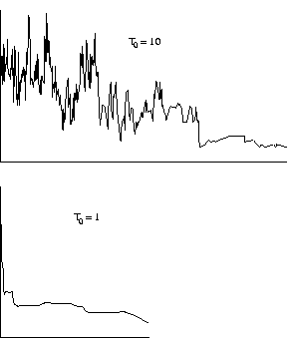
Convergence
Starting with higher
initial temperature
leads to more iterations
before convergence

Slide 60
Parking Garage
Parking garage has S stalls
Car arrivals fit Poisson distribution with mean A
Stay in garage fits a normal distribution with mean M and standard deviation M/S

Slide 61
Implementation Idea
Times Spaces Are Available
101.2
142.1
70.3
91.7
223.1
Current Time
Car Count
Cars Rejected
64.2
15
2

Slide 62
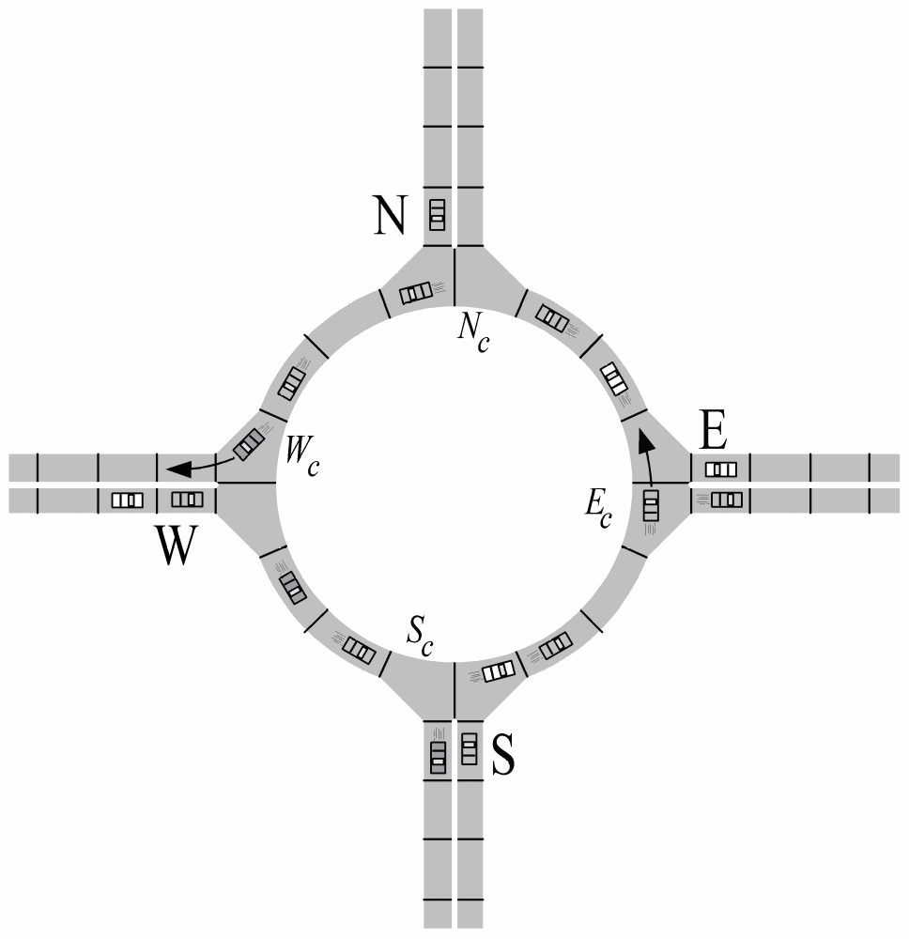
Traffic Circle

Slide 63
Traffic Circle Probabilities
 | F
N | 0.33
E | 0.50
S | 0.25
W | 0.33
D | N | E | S | W
N | 0.1 | 0.2 | 0.5 | 0.2
E | 0.3 | 0.1 | 0.2 | 0.4
S | 0.5 | 0.3 | 0.1 | 0.1
W | 0.2 | 0.4 | 0.3 | 0.1

Slide 64
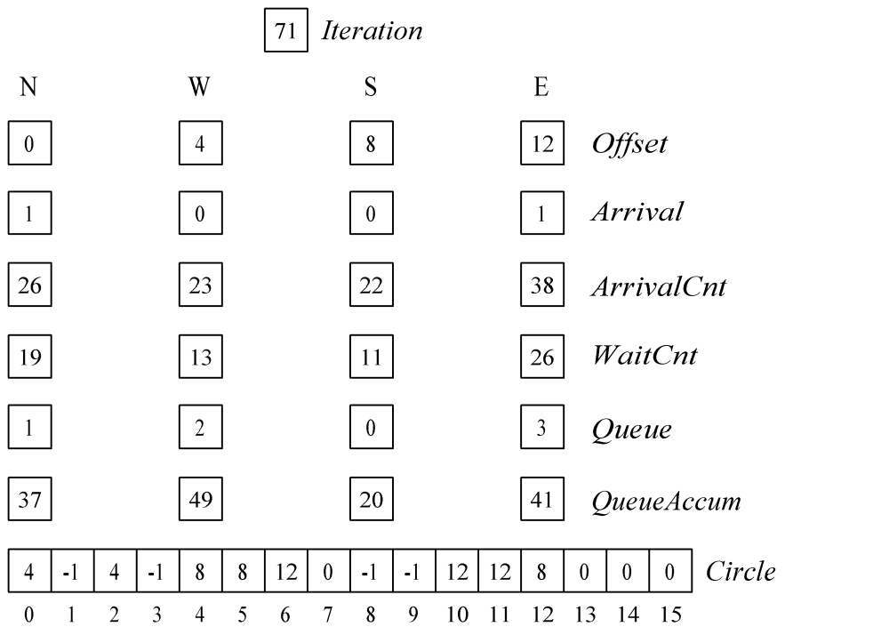
Traffic Circle Data Structures

Slide 65
Summary (1/3)
Applications of Monte Carlo methods
  Numerical integration
  Simulation
Random number generators
  Linear congruential
  Lagged Fibonacci

Slide 66
Summary (2/3)
Parallel random number generators
  Manager/worker
  Leapfrog
  Sequence splitting
  Independent sequences
Non-uniform distributions
  Analytical transformations
  Box-Muller transformation
  Rejection method

Slide 67
Summary (3/3)
Concepts revealed in case studies
  Monte Carlo time
  Random walk
  Metropolis algorithm
  Simulated annealing
  Modeling queues

